Slide 1


Multi-Purpose AI Password Analysis Tool
Offensive and Defensive AI Warfare

Slide 2

Multi-Purpose AI Password Analysis Tool
Group Members
Osama Khalid (Team Leader)
Sardar M.Zeeshan khan
Salman Ali
Department of Computing, Riphah International University, I-14, Islamabad.
Supervisor: Dr. Mansoor Alam

Slide 3

"The only truly secure system is one that is completely powered off, cast in concrete, and sealed in a lead-lined box buried a mile underground ."
-Bruce Schneier (security expert)

Slide 4
Table of Content
Introduction and Background
Opportunities and Stake Holders
Existing Systems
Requirements
Software System
Endeavour
Next Steps
Prototype / Report

Slide 5

Introduction and Background

Slide 6

AI: Transforming Offensive and Defensive Security
Offensive Applications:
Threat Modeling
Vulnerability Analysis
Automated Attacks
Defensive Applications:
Anomaly Detection
Intrusion Prevention.
Personalized Security Solutions

Slide 7

Opportunities and Stake Holders

Slide 8

Opportunities
Enhanced Security Assessments: Businesses and individuals can leverage the tool for penetration testing and vulnerability assessments, identifying potential weaknesses in their password security policies and practices.
AI-driven Offensive and Defensive Capabilities: Utilizing AI for both offensive (password cracking) and defensive (password strength assessment) purposes provides a comprehensive approach to password security management.

Slide 9

Stake Holders
Businesses: Companies aiming to improve their overall cybersecurity posture by identifying and mitigating password-related vulnerabilities.
Security Professionals: Penetration testers and security consultants who can use the tool for vulnerability assessments and ethical hacking activities.
Law Enforcement: Agencies might leverage the tool for lawful investigations adhering to court orders and legal guidelines.

Slide 10

Existing Systems

Slide 11
Tool | John the Ripper | RainbowCrack | OphCrack | L0phtCrack | Aircrack-ng
Type | Password Cracker | Password Cracker | Password Cracker | Password Cracker | Wi-Fi Network Security Tool
Supported Platforms | Windows, Linux, macOS | Windows, Linux | Windows, Linux | Windows | Linux, macOS
Password Hashes Supported | Various (Unix, Windows, etc.) | LM, NTLM, MD5, SHA1, SHA256, SHA512 | LM, NTLM | LM, NTLM | WEP, WPA, WPA2
Attack Methods | Dictionary, Brute Force, Hybrid | Precomputed Hash Tables | Rainbow Tables, Brute Force | Dictionary, Brute Force | Dictionary, Brute Force, WPS PIN
Speed | Fast | Depends on Rainbow Table size | Moderate | Fast | Depends on hardware and complexity of the password
User Interface | Command Line | Command Line | GUI | GUI | Command Line
License | Open Source | Freeware | Open Source | Commercial | Open Source
Usage | Penetration Testing, Password Auditing | Password Cracking | Password Recovery | Password Cracking | Wi-Fi Network Security Testi

Slide 12

"Your password is the key to your digital life. Choose it wisely, and guard it fiercely."

Slide 13
Requirements

Slide 14
Requirements
Hardware Requirements
Software Requirements
Dataset Requirements

Slide 15
Hardware Requirements
Workstation HP Z840
Processor Intel Xeon E5-2680 V4 Dual
RAM 64GB DDR4 ECC
GPU RTX 3070TI 8GB GDDR6x.
SSD 512 GB

Slide 16
Software Requirements
Windows 11 64bit
Visual Studio
Python 3.12
TensorFlow
Pytroch
cuDNN

Slide 17
Preparing Datasets
Splitting the Dataset
Data Cleaning
Save the Preprocessed Dataset

Slide 18
Datasets Requirements

Slide 19
Datasets
Get a mix of passwords from various sources, like:
Online leaks and breaches (follow ethical and legal guidelines).
Making sure our dataset covers a wide range of password types, including different lengths, complexities, and compositions.

Slide 20
Datasets Requirements

Slide 21
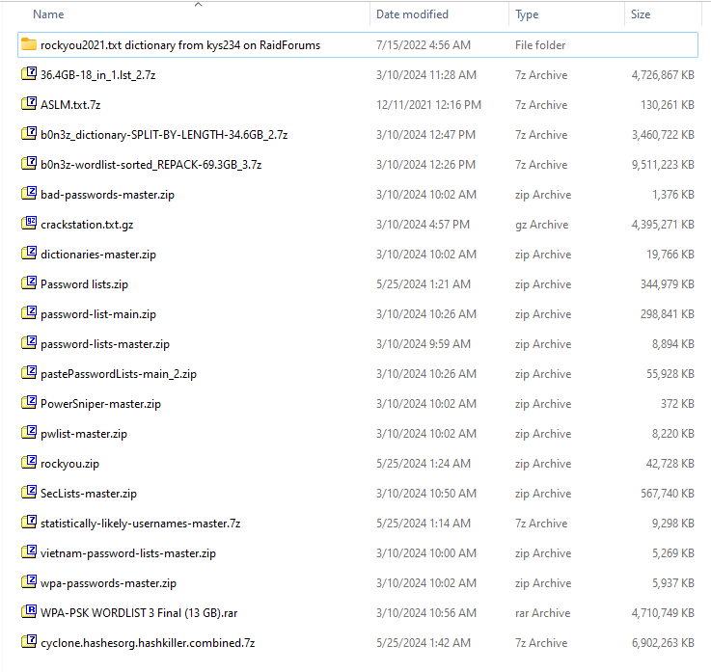
Datasets Requirements

Slide 22
Splitting the Dataset
Efficient Space Utilization: Smaller files are easier to manage on storage media.
Reduced Memory Usage: Processing smaller chunks reduces the need for large memory allocation.
System Compatibility: Some systems and applications have limitations on file size they can handle.
User-Friendly: Simplifies handling for end-users who may not have tools to manage large files.

Slide 23
Data Cleaning
Removing corrupted entries
Remove Weird entries
Filter the password of length of 5 to 8 as per our project Requirements

Slide 24
Save the Preprocessed Dataset
Saved the Processed Data into txt file format.

Slide 25
Software System
Design

Slide 26
Software System Design
Dataset
Algorithms
Data Splitter
Data Filter
RNN Train
RNN generate
Transformer Train
Transformer Generate
GANS Train
GANs Generate

Slide 27
Dataset
Design

Slide 28
Data Splitter

Slide 29
Data Filter

Slide 30
Algorithms
Design

Slide 31
RNN Train

Slide 32
RNN Generate

Slide 33
Transformer Train

Slide 34
Transformer Generate

Slide 35
GANs Train

Slide 36
GANs Generate

Slide 37
Endeavour

Slide 38
WBS # | WBS Deliverable | Activity # | Activity to Complete the Deliverable | Responsible Team Member(s) & Role(s)
1 | Requirements | 1.1 | Hardware Requirements | Osama Khalid
 |  | 1.2 | Software Requirements | Osama Khalid, Zeeshan Khan, Salman Ali
2 | Phase 1: Develop and Train the AI Model | 2.1 | Research and select appropriate AI algorithms for password analysis. | Osama Khalid, Zeeshan Khan, Salman Ali
 |  | 2.2 | Acquire or prepare relevant password datasets for training. | Zeeshan Khan
 |  | 2.3 | Train and optimize the chosen AI model with the selected datasets. | Osama Khalid
3 | Phase 2: Implement Core Functionalities | 3.1 | Design and develop functionalities for password strength analysis. | Osama Khalid, Zeeshan Khan, Salman Ali
 |  | 3.2 | (Optional) Integrate password breach checking with online databases (securely).
 |  | 3.3 | Develop functionalities for automated password cracking (ethical considerations apply). | Osama Khalid, Zeeshan Khan, Salman Ali
4 | Phase 3: Design and Develop User Interface | 4.1 | Design a user-friendly interface for both offensive and defensive functionalities.
 |  | 4.2 | Integrate the trained AI model and core functionalities into the user interface.
5 | Phase 4: Testing and Refinement | 5.1 | Conduct thorough testing of all functionalities with various password scenarios. | Osama Khalid, Zeeshan Khan, Salman Ali
 |  | 5.2 | Refine the AI model, user interface, and functionalities based on testing results.
 |  | 5.3 | Document user manuals and instructions for the completed tool.

Slide 39

Any Question?
27971@students.riphah.edu.pk

Slide 40

References
https://posts.specterops.io/deeppass-finding-passwords-with-deep-learning-4d31c534cd00
https://ieeexplore.ieee.org/abstract/document/9552430
https://www.sciencedirect.com/science/article/pii/S0020025518302366?casa_token=QnobZtTT-nQAAAAA:ZUQdmVBOId58XFG1Sp5xbuBLQdIui7dvw4fKJzUqfwLr6doVbFtBep38V2hDqVt_26zTbM_Sj5I

